Slide 1


Slide 2


Slide 3


Outline
Introduction
Objectives
Problems we are trying to solve
Solution
Our services
Competitive advantages
Drawbacks
Speciality of this project
Future plan
Activity Model
Use case diagram
Class Diagram
Conclusion

Slide 4

Introduction
Our app is based on augmented reality.
Augmented reality is an interactive experience of a real-world environment where the objects that reside in the real world are enhanced by computer-generated perceptual information, sometimes across multiple sensory modalities, including visual, auditory, haptic, somatosensory and olfactory.
4

Slide 5
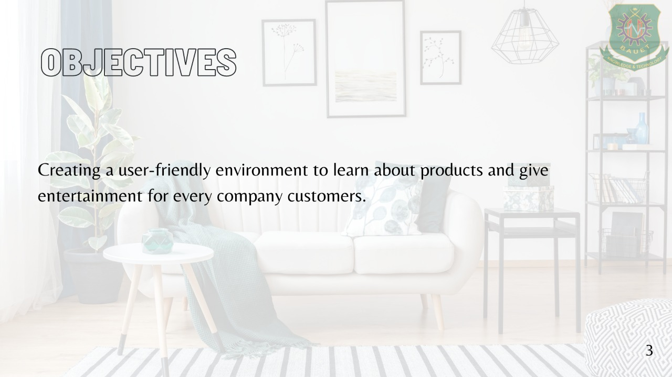
5
04.08.2021

Slide 6
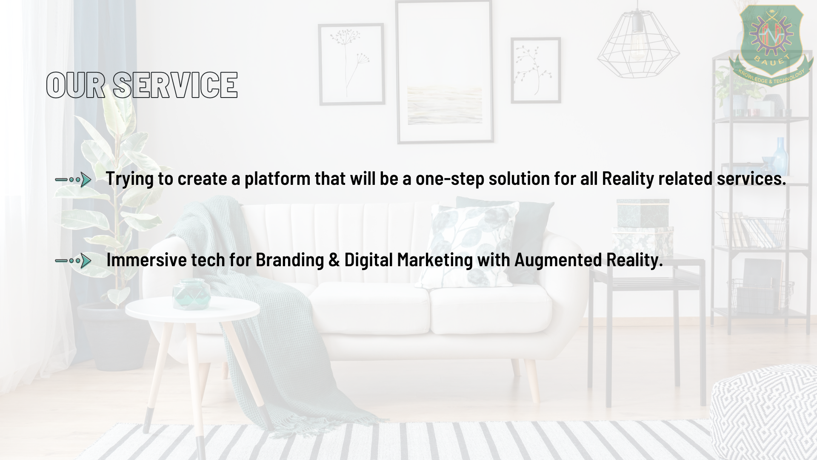
6
5

Slide 7
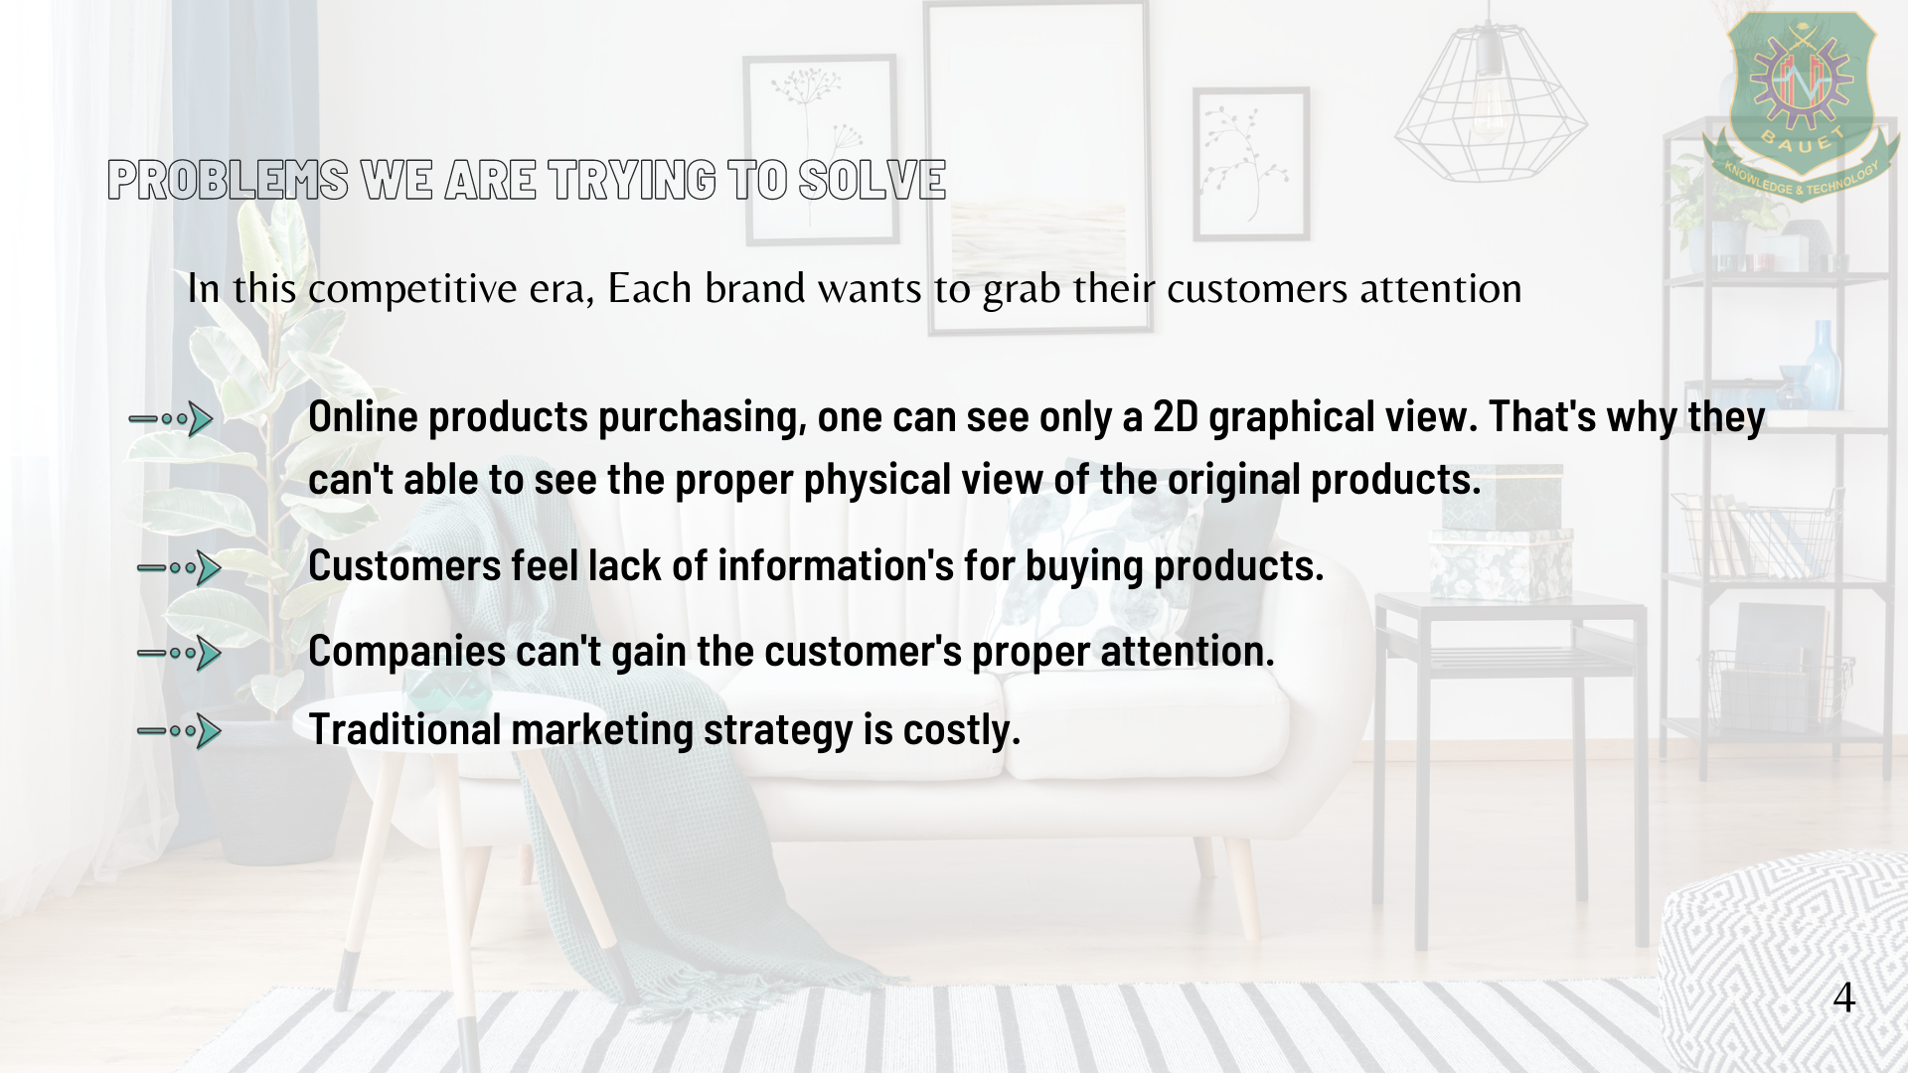
7

Slide 8
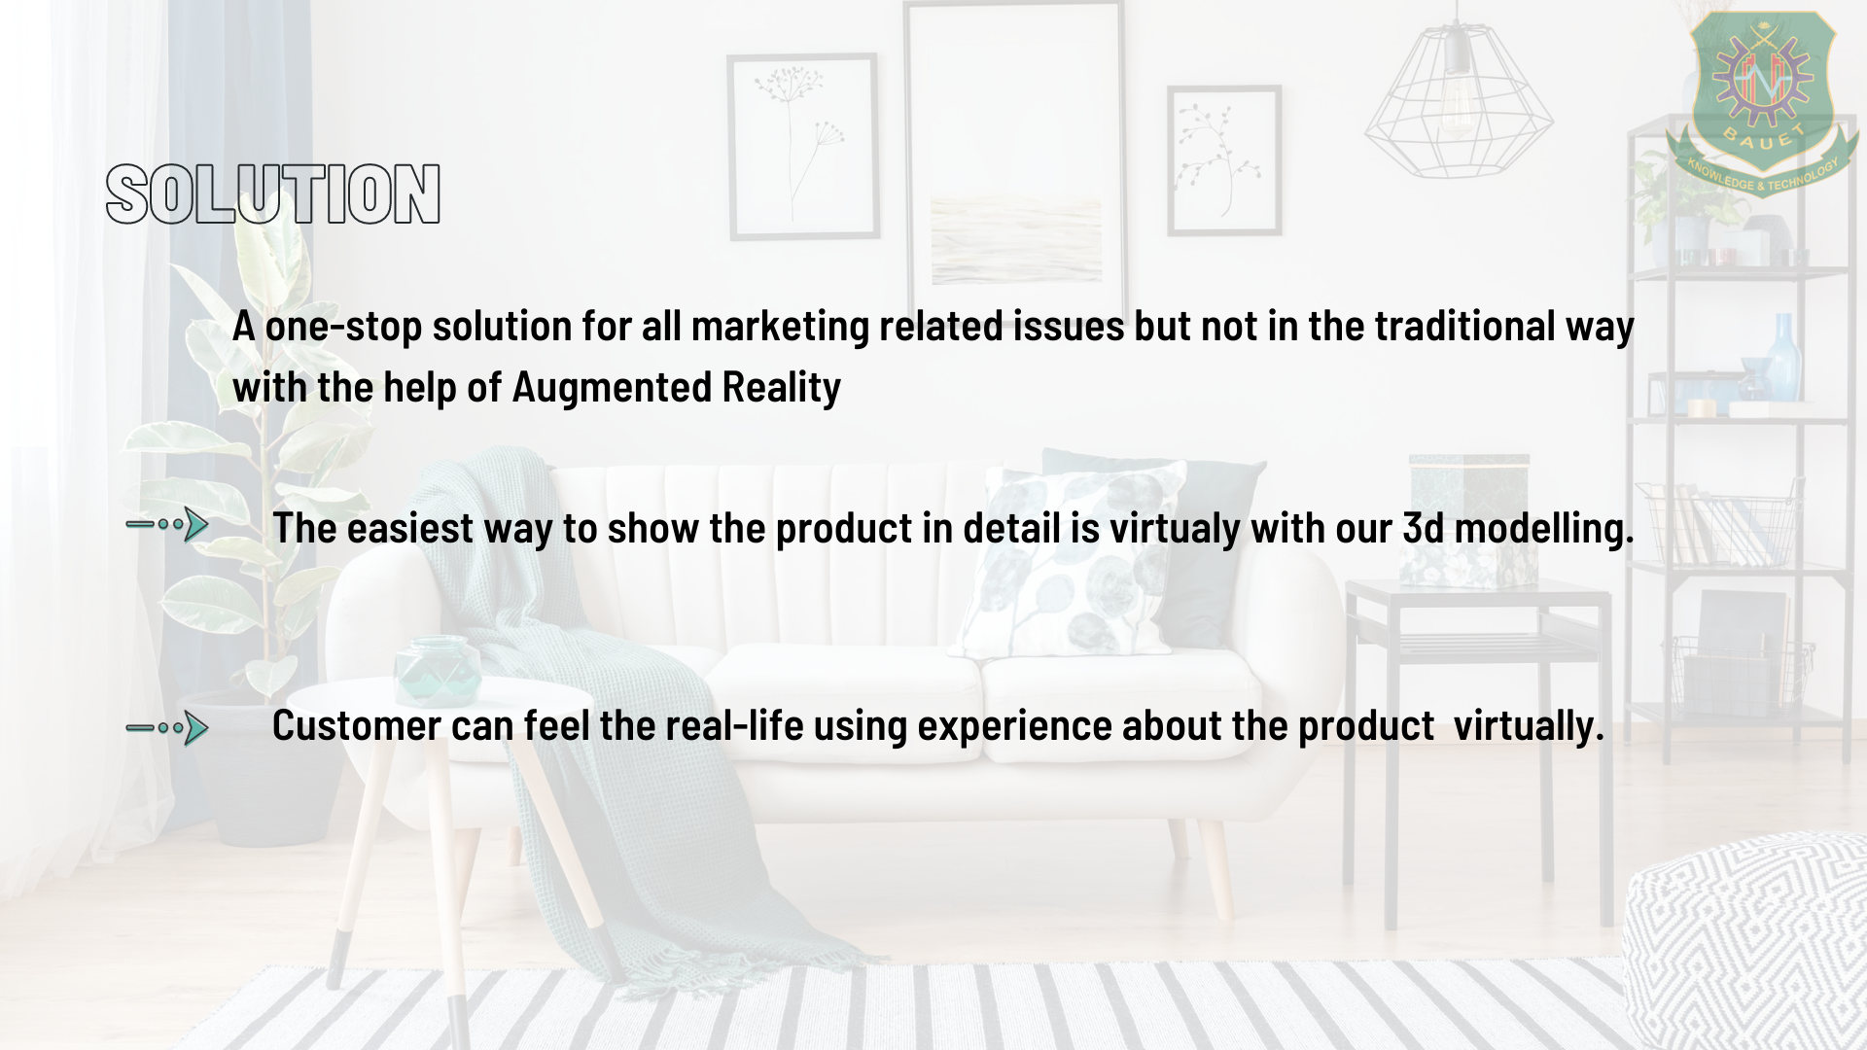
6
8

Slide 9
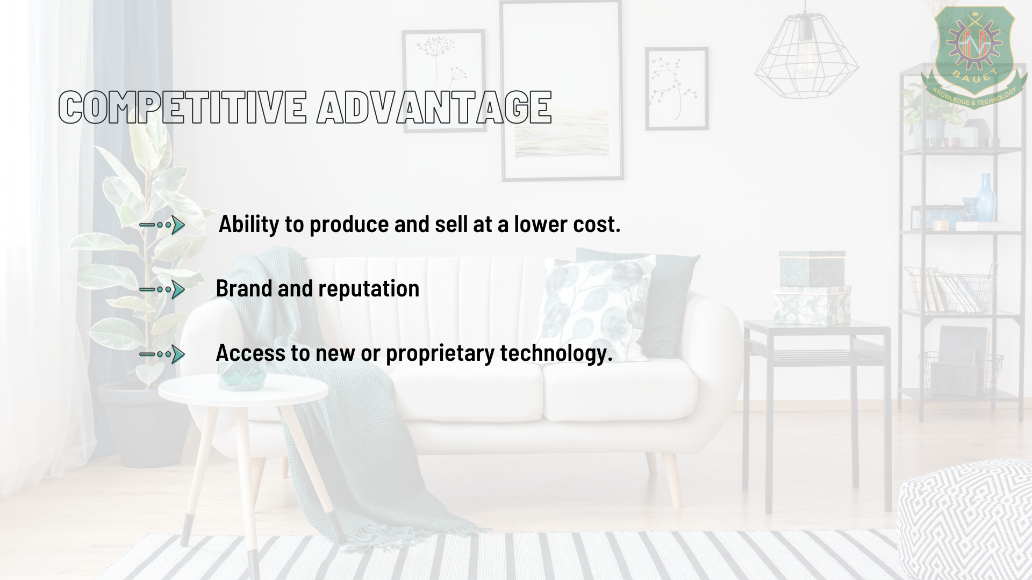
7
9

Slide 10
Drawbacks
Need more time to update our app then the companies.
Augmented reality is not too much familiar to our country. We have to invest time & money in advertisement at first.
10

Slide 11
Speciality of this project
We are creating a new online marketing way.
User can experience 3D graphical view of that product.
11

Slide 12
Future plan
We will add server system
11

Slide 13
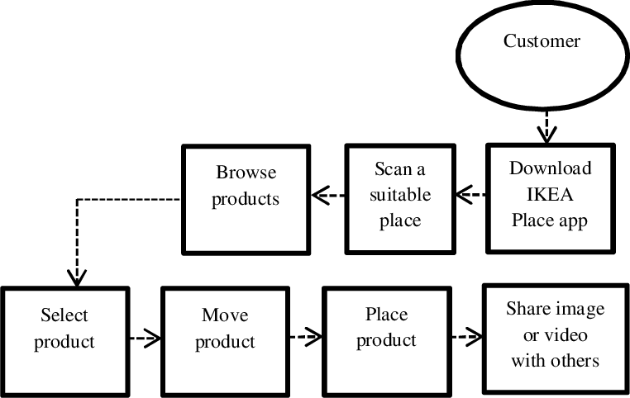
Activity Model
The App
12

Slide 14

Use case diagram
Actor
Use Case-Function
System
Package
13

Slide 15

Use case diagram
System Boundary
All necessary documents collect & Store
<<include>>
Log in
Select Furniture & Give access to phone camera
Cash on Delivery
<<extend>>
View Products
Camera on
Order
Cancel Order
<<extend>>
View Price
Online payment
Customer
Admin
14

Slide 16
Class diagram
CustomerDetails
ShoppingCart
Furniture
-Name: String
-Email: string
-Phone number: int
-Address: string
+update(item : int): boolean
+remove (item: int): boolean
+buy (): Order
-ID: int
-Description: string
-Price: Double
Customer
Order
-User ID: int
-Password: string
-ID: int
-Date: date
-Price:Double
+addDetails: (CustomerDetails: string): boolean
+deleteDetails (CustomerDetails: string): boolean
+editEmail (CustomerDetails: string): boolean
+editPassword (CustomerDetails: string): boolean
+updateCart (ShoppingCart: int): boolean
+buy():void
+updateOrder: (status: OrderDetails)
+createBill(): Bill
Bill
OrderDetails
New
Pending
Delivered
Canceled
-date: date
-price: double
15

Slide 17
Conclusion
People are getting busy day by day, at the same time people can’t get out frequently. So, this app will be a lot of time savior for our daily life.
16

Slide 18

Thank You
17

Slide 19
Any Query?
18

